Slide 1
Order 4: Pezizales
Involve the fungi that apothecia on the surface of the soil, and their asci with operculum.
Most of them are saprobes.
Asexual reproduction is unknown.
These fungi involve two families:
Family 1: Pezizaceae:
Pezizaceae are mostly cup- disc, or sessile to stalked; minute to very
Large; bright-colored to dark-brown; smooth, velvety, hairy.
Apothecia reach to 5cm or more.
Ex; Pezizaaurantia; Orange in color, edible (spongefungus), sessile apothecium.

Slide 2
Family 2; Morchellaceae:
Morchellaceae is characterized by large, stalked apothecia.
Apothecia reach to 14cm.
Grayish white to a dark-brown in color.
Morchellaspp.
The ascocarps are hypogean and remain closed in most species, liberating the ascospores only when the ascocarp decays or broken by animals.

Slide 3
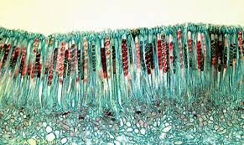

Slide 4
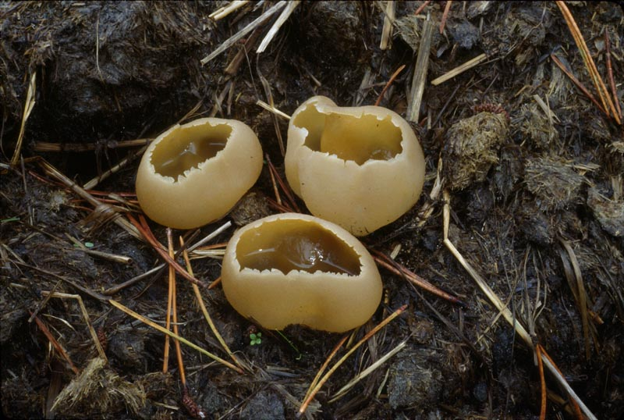

Slide 5
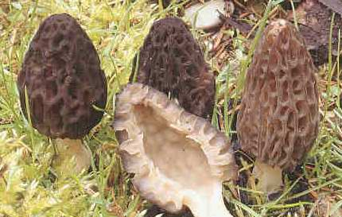

Slide 6
